Slide 1


Lead Score Case Study
YASH KHATAVKAR NAMAN CHAUDHARY

Slide 2
Problem Statement
X Education sells online courses to industry professionals.
X Education gets a lot of leads, however its lead conversion rate is very poor. For example, if, for example, they acquire 100 leads in a day, they only manage to convert 30 of them.
To make this process more efficient, the company wishes to identify the most potential leads, also
known as ‘Hot Leads’.
If they successfully identify this set of leads, the lead conversion rate should go up as the sales team will now be focusing more on communicating with the potential leads rather than making calls to everyone.
Business Objective:
X education wants to know most promising leads.
For that they want to build a Model which identifies the hot leads.
Deployment of the model for the future use.

Slide 3
Solution Methodology
Data cleaning and data manipulation.
Check and handle duplicate data.
Check and handle NA values and missing values
Drop columns, if it contains large amount of missing values and not useful for the analysis.
Imputation of the values, if necessary
Check and handle outliers in data
EDA
Univariate data analysis: value count, distribution of variable etc.
Bivariate data analysis: correlation coefficients and pattern between the variables etc.
Feature Scaling & Dummy Variables and encoding of the data.
Classification technique: logistic regression used for the model making and prediction.
Validation of the model.
Model presentation.
Conclusions and recommendations.

Slide 4
Data Manipulation
Total Number of Rows = 37, Total Number of Columns = 9240.
Single value features like “Magazine”, “Receive More Updates About Our Courses”, “Update me on Supply” , Chain Content”, “Get updates on DM Content”, “I agree to pay the amount through cheque” etc. have been dropped.
Removed the “Prospect ID” and “Lead Number” which is not necessary for the analysis.
After checking for the value counts for some of the object type variables, we find some of the features which have not enough variance, which we have dropped, the features are: “Do Not Call”, “What matters most to you in choosing course”, “Search”, “Newspaper Article”, “X Education Forums”, “Newspaper”, “Digital Advertisement” etc.
Dropping the columns having more than 35% as missing value such as ‘How did you hear about X Education’ and ‘Lead Profile’.

Slide 5
EDA

Slide 6
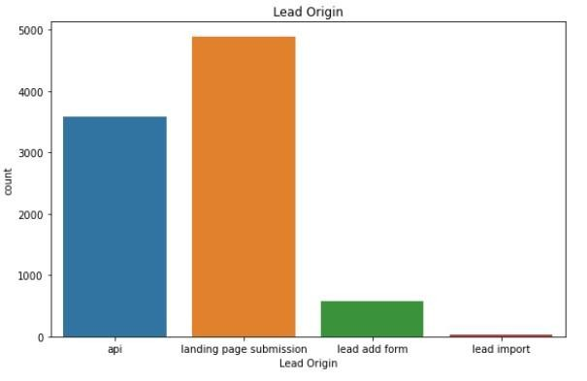
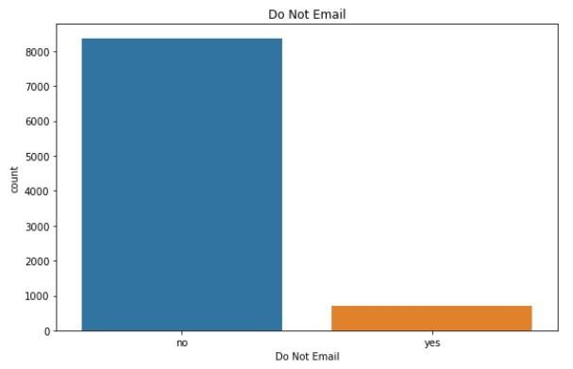
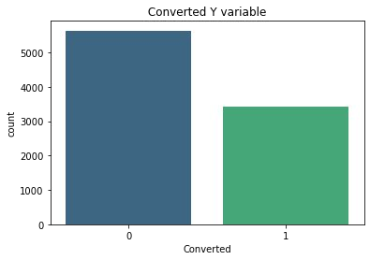
Numerical variables

Slide 7
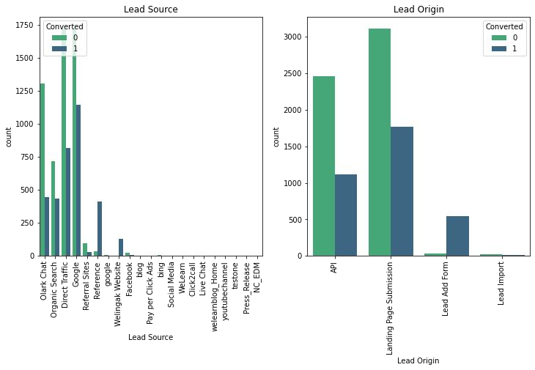
Categorical variable relation

Slide 8
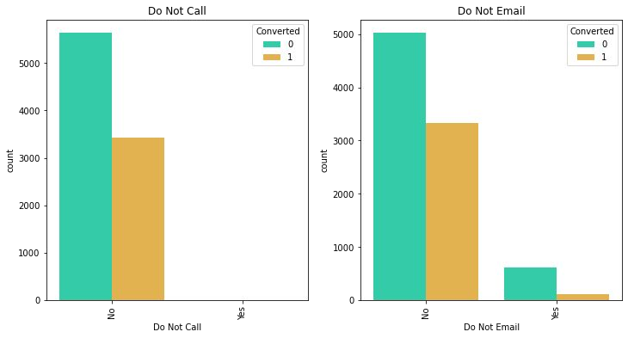
Categorical variables

Slide 9
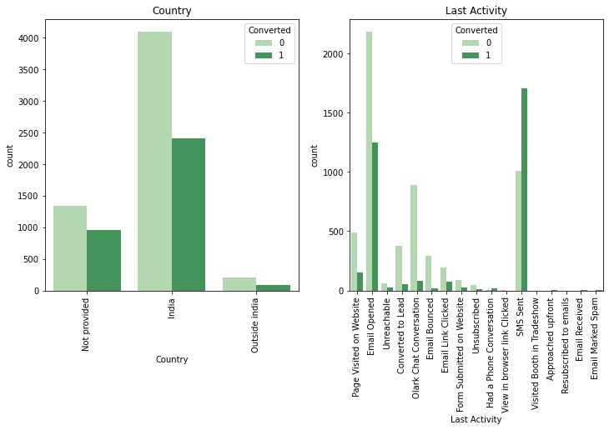
Categorical variables

Slide 10
Data Conversion
Numerical Variables are Normalised
Dummy Variables are created for object type variables
Total Rows for Analysis: 8792
Total Columns for Analysis: 43

Slide 11
Model Building
Splitting the data into training and testing sets
The basic step for regression is performing the test – train split, we have chosen a 70:30 ratio.
We have used RFE for feature selection
We run RFE with 15 variables as output
We build the model by removing the variable whose p-value is greater than 0.05 and vif value is greater than 5.
Perform predictions on the test data set
Overall accuracy 81%

Slide 12
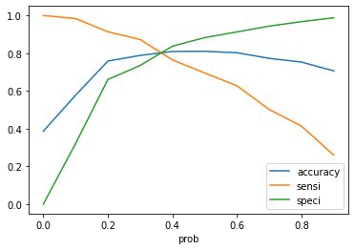
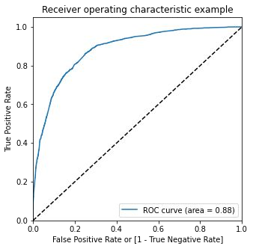
ROC Curve
Finding Optimal Cut off Point
Optimal cut off probability is that probability where we get balanced sensitivity and specificity.
From second graph it is visible that the optimal cut off is 0.35.

Slide 13
Conclusion
In conclusion we noted the the most important variables for the potential buyers are
The total number of visits by the potential buyer
Total time spent on the website by the potential buyer
If the lead source was
Direct traffic
Google
Welingak website
Organic search
If the last activity was
SMS
an Olark chat conversation
If the origin of the lead is the lead add format
If their current occupation is a working professional
If the client keeps these parameters in mind then there is a good chance of converting more leads to buyers

